Slide 1
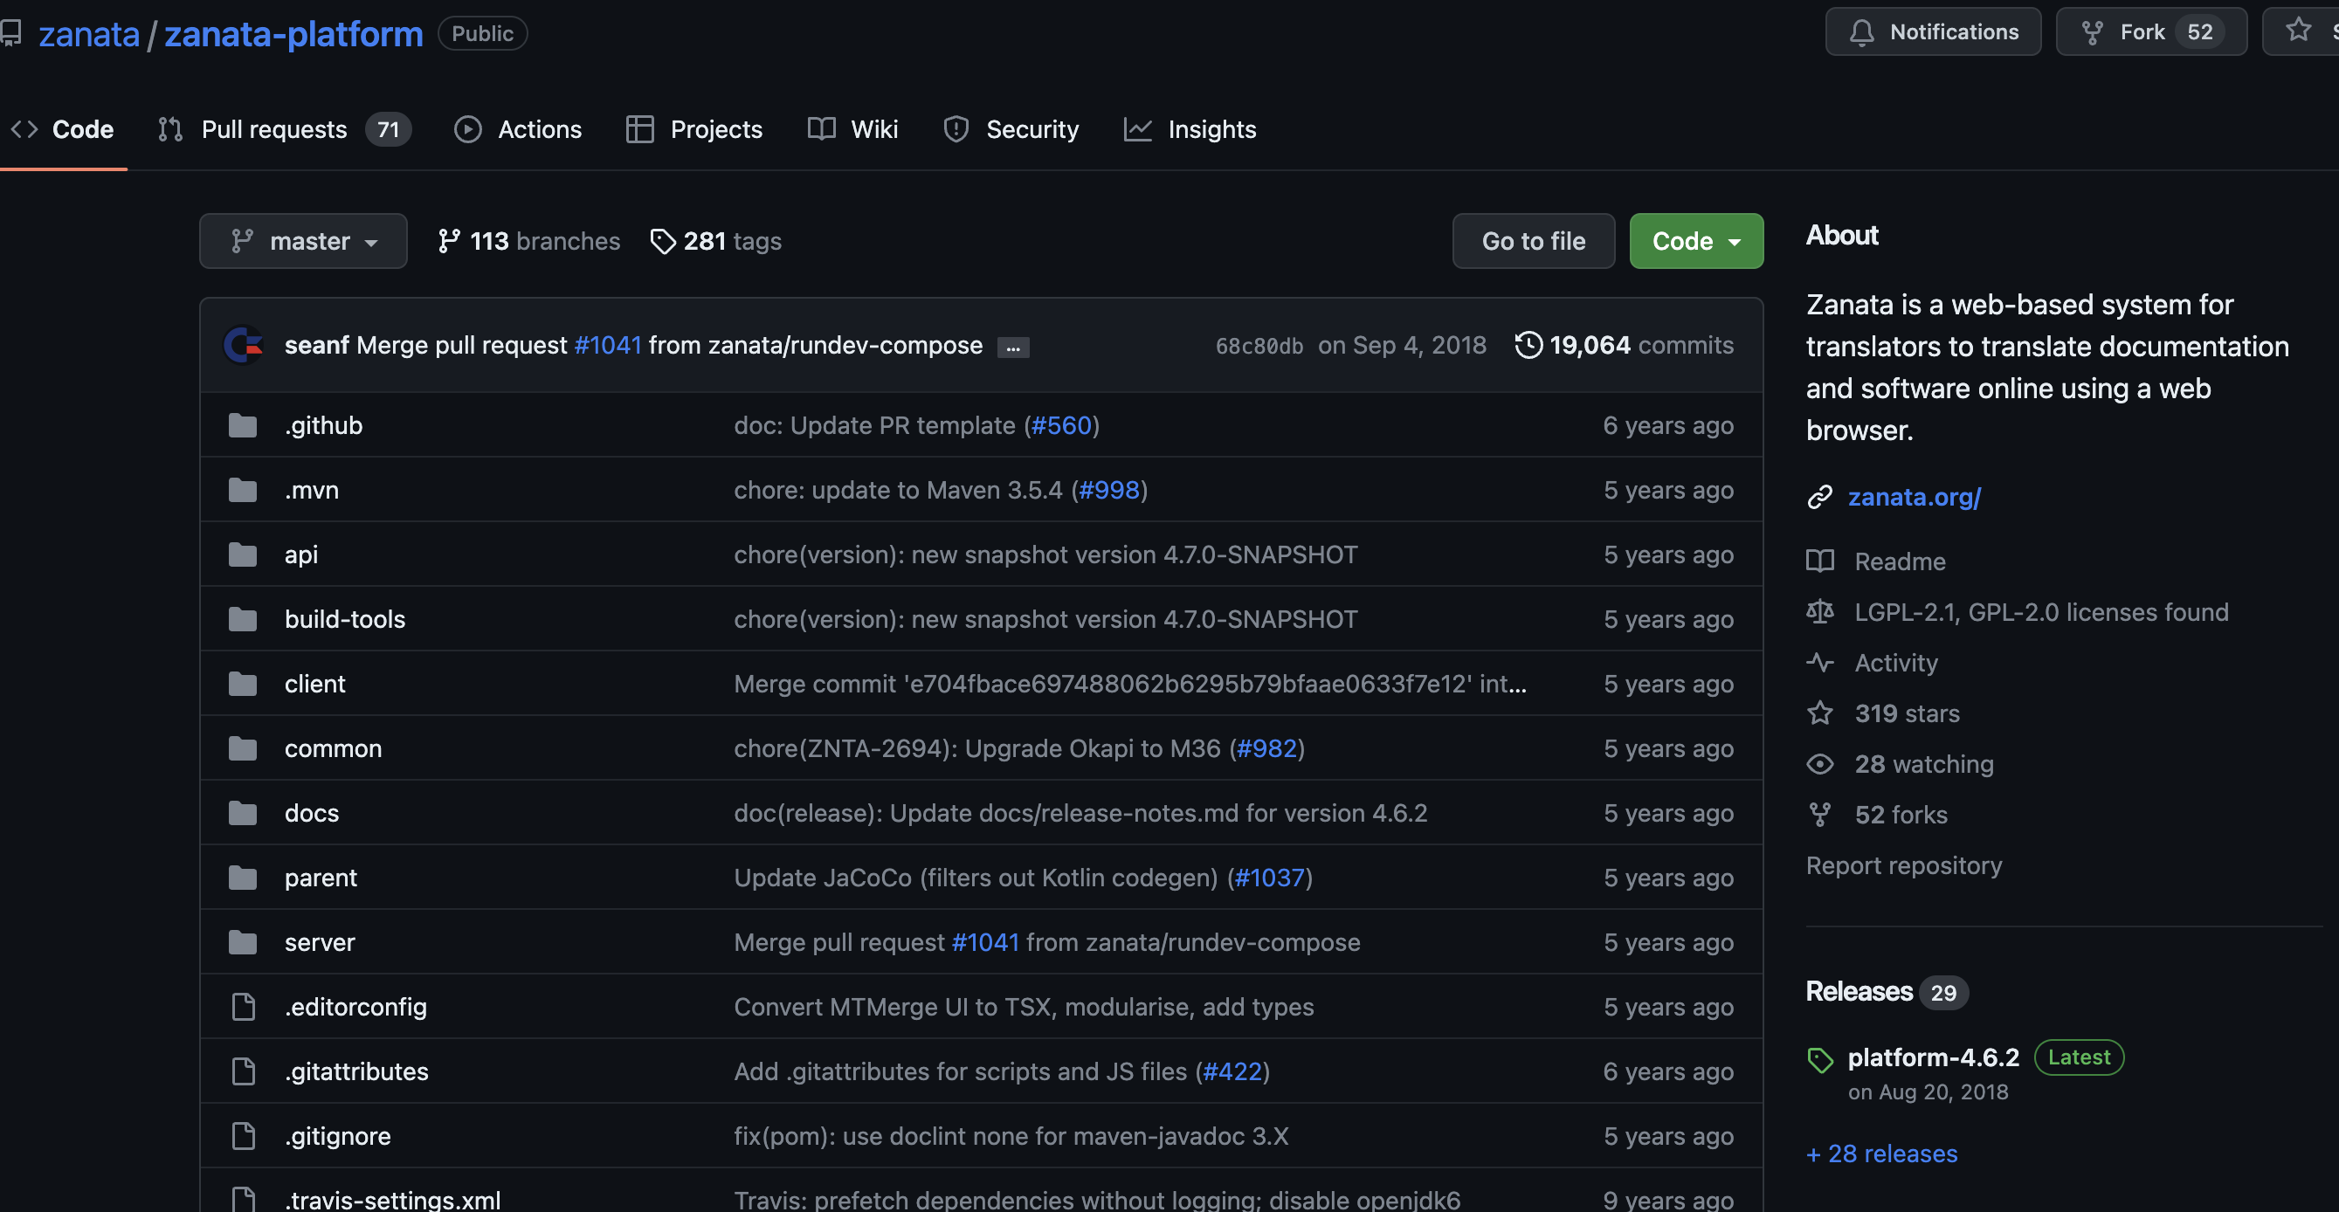
Demo
Problem:
Zanata does not receive any updates from 2018 by IBM.

Slide 2
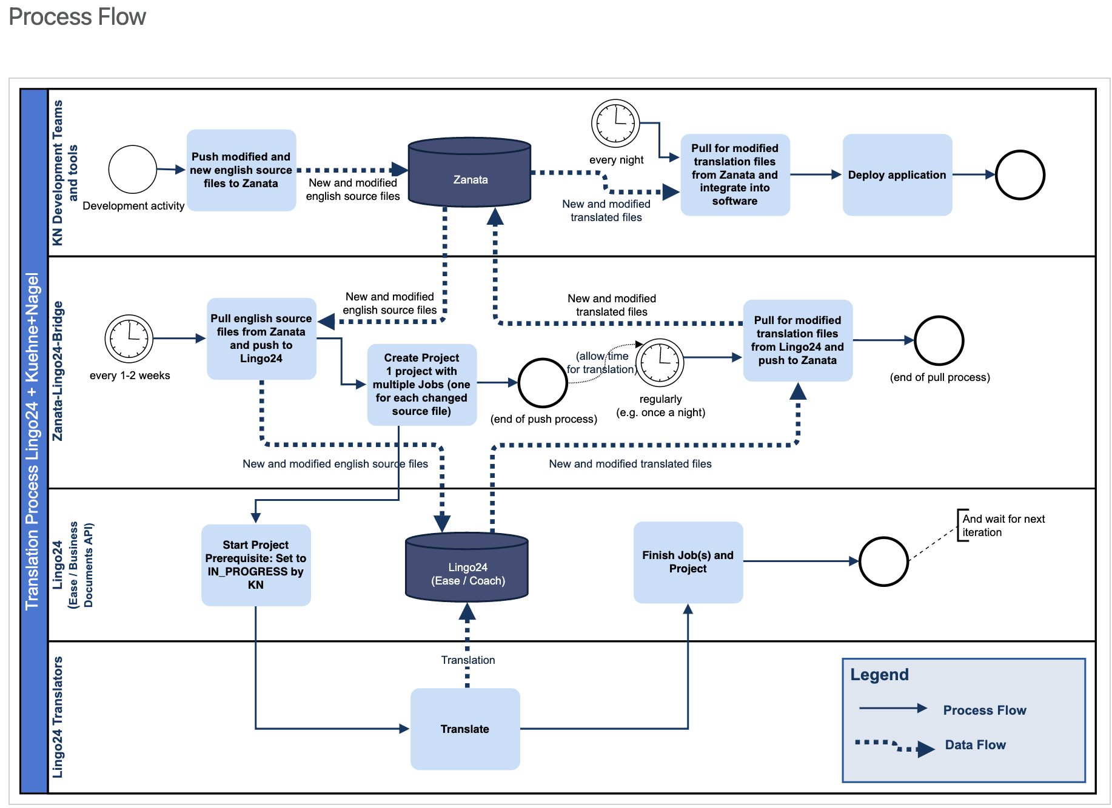
Demo
Problem:
Current translation process is old & slow.

Slide 3
Demo
Problem:
Limited control over the translations.
Complex to control the quality of the translations.
100 % missing translations in Danish and Swedish languages.
Incomplete translations in Turkish 40.65%, Korean 51.68%.
KN is contracting the UK based company Lingo24 - $$$.
Reference: https://mykn-zanata.int.kn/iteration/view/mykn-quote-book-air/RESOURCES_UI/languages/tr?dswid=-4328

Slide 4
Demo
Solution:
KN Translator platform based on AI/ML datasets.
Access to translations via UI interface.
Save current & future translations in DB.
Improve constantly the platform.
Save on cost.

Slide 5
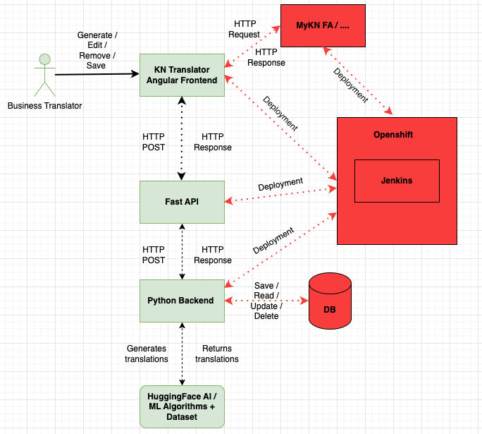
Demo

